Slide 1

Applications of Multiagent Systems in Game Theory
Todoran Ciprian Bogdan
Babeş-Bolyai University, 2026

Slide 2




Research Motivation
Strategic Modeling
Autonomous MAS
Translating complex real-world decision-making into mathematical frameworks across economics and computer science.
Exploring how autonomous agents use strategic reasoning to solve coordination and competition problems independently.

Slide 3


Defining the Core Disciplines
Game Theory (GT)
Multiagent Systems (MAS)
The mathematical rulebook of strategic interaction. It dictates how rational actors compete, cooperate and reach stable equilibria. Provides the theoretical optimum.
The autonomous executors. Distributed computational entities capable of navigating complex environments. Provides the practical simulation and validation.

Slide 4

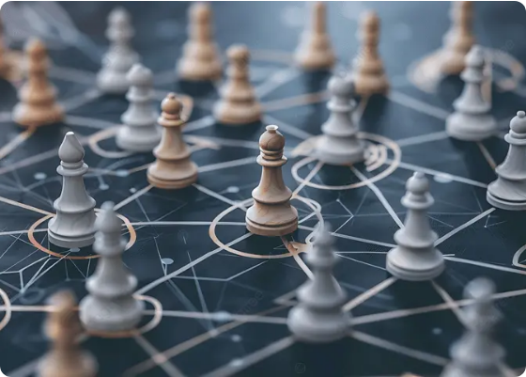
Game Theory Fundamentals
Game Theory (GT) is the study of mathematical models describing strategic interaction between rational decision-makers.
Origin: von Neumann and Morgenstern (1944).
Evolution: Expanded from simple zero-sum games to non-zero-sum cooperation.
Equilibrium: Finding stable states where no player gains by changing strategy alone (Nash Equilibrium).
“Game Theory” of ”Myerson, R.B.” “Theory of Games and Economic Behavior” [19], Oskar Morgenstern and Jhon von Neumann

Slide 5








Game Theory Structures
Game Type | Definition | Key Focus
Cooperative | Players form binding agreements/coalitions. | Collective Welfare
Non-Cooperative | Independent actions without contracts. | Nash Equilibrium
Symmetric | Identical roles and payoff structures. | Role Permutation
Zero-Sum | One player's gain is another's loss. | Strict Competition
Alignment
Symmetry
Value Distribution
Timing
Cooperative (binding agreements) vs. Non-Cooperative (Nash equilibria).
Symmetric (identical roles) vs. Asymmetric (differing reward rules).
Zero-Sum (fixed payoff) vs. Non-Zero-Sum (mutual gain/loss possible).
Simultaneous (blind action) vs. Sequential (perfect information moves).

Slide 6






E-Commerce Applications
Shopbots
Pricebots
Negotiation
Automated agents searching for the best quality products at the lowest cost for human buyers.
Sellers' agents that adjust prices dynamically based on market demand while avoiding "price wars."
Programs reaching agreements without human intervention using mathematical strategy rules.
“Game Theory and Decision Theory in Multi-Agent Systems” by ”Parsons Simon and Wooldridge Michael”

Slide 7
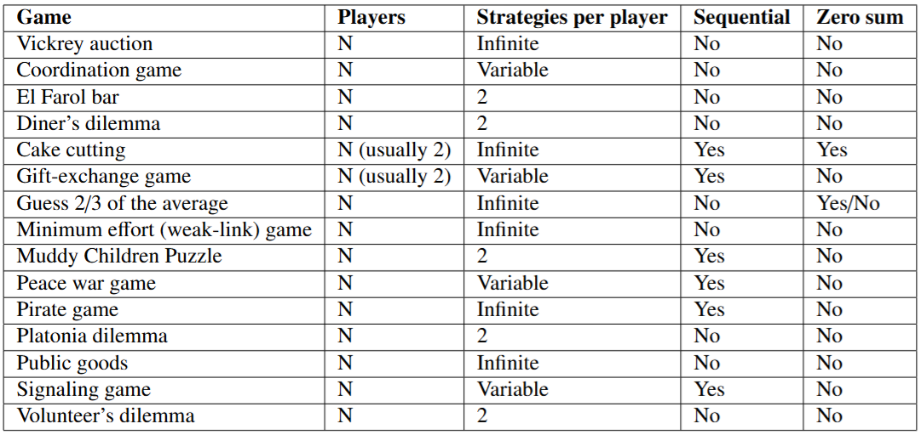
Game Theory - Games

Slide 8
Minimum Effort Game (MEG)
The Minimum Effort Game, also known as the Weakest Link Game, is a coordination game used to study how groups work together. In this model, the final success of a group is determined by the member who provides the lowest level of effort.
“π_{i}” : The payoff for player “i”
“a”: The benefit earned from the group's minimum effort
“b”: The cost of the player's own effort
“e_{i}”: The effort level chosen by player “i”
“c”: A constant value to ensure the reward is not a negative number Constraint: a > b > 0 (Motivation to align with minimum) Outcome: One weak performance affects everyone negatively. Since the benefit (“a”) is higher than the cost (“b”), players are motivated to work hard, but only as hard as the slowest player
“Efficient coordination in weakest-link games” by “Arno Riedl, Ingrid M.T. Rohde and Martin Strobel”

Slide 9
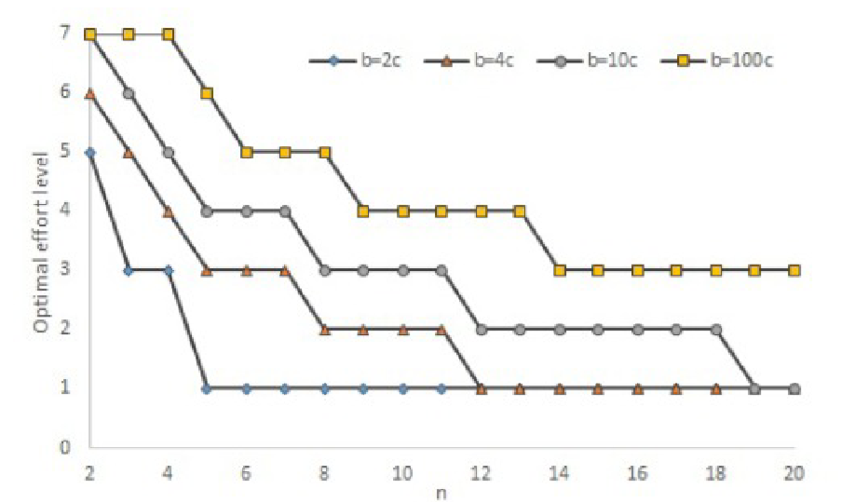
MEG Literature Results
“The Optimal Strategy in the Minimum Effort Game” by “Edward Cartwright”
Coordination Failure: Agents converge to the lowest effort (Equilibrium) to avoid payoff losses.

Slide 10
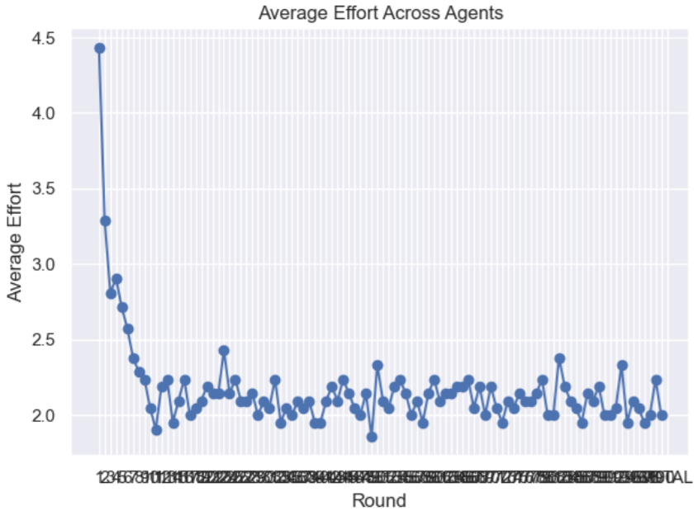
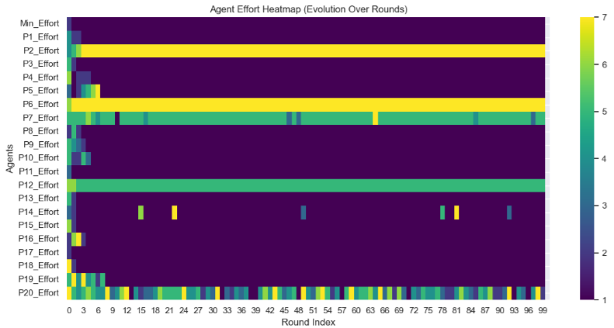
MEG Simulation Results
The simulation results are consistent with the conclusions presented in the literature review, especially with the findings of Cartwright. Both the theoretical analysis and the simulation show that players tend to converge toward low-effort equilibria instead of maintaining socially efficient high-effort coordination.
Coordination Failure: Agents converge to the lowest effort (Equilibrium) to avoid payoff losses.

Slide 11

Vickrey Auction Model
Introduced by William Vickrey in 1961 Type of sealed-bid auction: all bids are submitted secretly Winner is the highest bidder, but pays the second-highest bid price
Game mechanism:
Each participant has:
Bid: bi
True valuation: vi
Auction rule: highest bi wins, payment second-highest bid
Strategic Insight
Optimal strategy: bid your true value (bi=vi)
Bidding below true value reduces chance of winning
Bidding above true value risks overpaying, possible loss

Slide 12
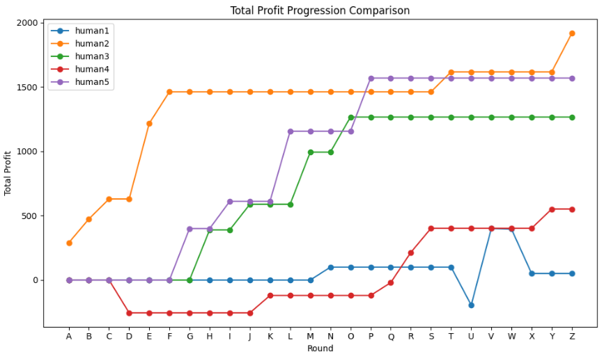
MEG Literature Results
“A Theoretical and Experimental Analysis of Bidding Behavior in Vickrey-Auction Games” by ”Werner G ̈uth, Rolf Schmittberger and Bernd Schwarze”
The optimal strategy is for each participant to bid their true value (b = v)

Slide 13
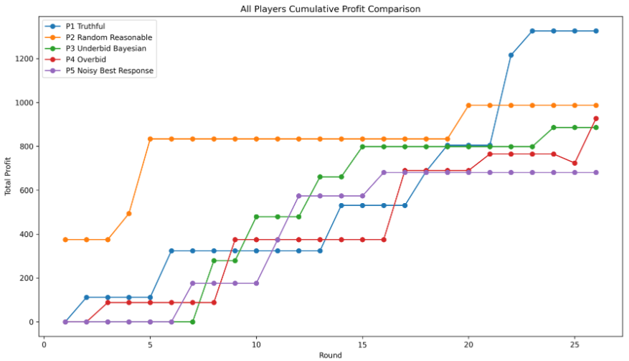
MEG Simulation Results
Human experiments often show irrational bidding due to psychological factors and misunderstanding, whereas simulations produce rational, consistent results. These controlled environments eliminate behavioral noise, making them more effective for testing and validating auction mechanisms.

Slide 14
Conclusions
MAS and Game Theory are strongly complementary for modelling strategic multi-agent decision problems
MAS enables simulation of autonomous interactions; GT provides formal strategic analysis tools
Case studies validated theory: effort convergence (coordination failure) and truthful bidding (Vickrey Auction)
Results confirm MAS as an effective experimental environment for testing game-theoretic predictions
Applications: decentralized systems, automated markets and negotiation systems
Future direction: scalable simulations with adaptive and learning-based agents

Slide 15
Questions?
MAS and GT are mutually reinforcing: MAS provides the framework for interaction, while GT offers the mathematical foundation for stability.
ciprian.todoran@stud.ubbcluj.ro Babeş-Bolyai University

Slide 16


Sources
https://png.pngtree.com/thumb_back/fw800/background/20260326/pngtree-strategic-chess-network-on-dark-abstract-surface-image_21620372.webp
Source: pngtree.com
https://grafe-auction.ghost.io/content/images/2024/06/Firefly-Digital-gavel-concept--Close-up-image-of-a-judge-s-gavel--but-instead-of-wood--it-s-made-of--copy.jpg
Source: www.grafeauction.com
[1] Cartwright, E., 2018. The optimal strategy in the minimum effort game. Games 9, 42.
[2] Chandrasekaran, R., 2016. Cooperative game theory. PDF). University of Texas at Dallas .
[3] Chang, K.H., 2014. Design theory and methods using CAD.
[4] Cooper, R., 1999. Coordination games. cambridge university Press.
[5] Costa-Gomes, M.A., Crawford, V.P., Iriberri, N., 2009. Comparing models of strategic thinking in van huyck, battalio, and beil’s coordination games. Journal of the European Economic Association 7, 365–376. URL: https://doi.org/10.1162/JEEA.2009.7.2-3.365
[6] Fujiwara-Greve, T., 2015. Non-cooperative game theory. Springer.
[7] G ̈uth, W., Schmittberger, R., Schwarze, B. A theoretical and experimental analysis of bidding behavior in vickrey-auction games.
Zeitschrift f ̈ur die gesamte Staatswissenschaft / Journal of Institutional and Theoretical Economics
[8] Hefti, A., 2017. Equilibria in symmetric games: Theory and applications. Theoretical Economics
URL: https://onlinelibrary.wiley.com/doi/abs/10.3982/TE2151, doi:https://doi.org/10.3982/TE2151,arXiv:https://onlinelibrary.wiley.com/doi/pdf/10.3982/TE2151.
[9] Huyck, J.B.V., Battalio, R.C., Beil, R.O., 1990. Tacit coordination games, strategic uncertainty, and coordination failure. The American
Economic Review 80, 234–248. URL: http://www.jstor.org/stable/2006745.
[10] Myerson, R.B., 2013. Game theory. Harvard university press.
[11] Nash Jr, J.F., 1950. Equilibrium points in n-person games. Proceedings of the national academy of sciences 36, 48–49.
[12] Owen, G., 2013. Game theory. Emerald Group Publishing.
[13] Pendharkar, P.C., 2012. Game theoretical applications for multi-agent systems. Expert Systems with Applications
[14] Riedl, A., Rohde, I.M., Strobel, M., 2016. Efficient coordination in weakest-link games. The Review of Economic Studies
[15] Sandholm, T., 2000. Issues in computational vickrey auctions. International Journal of Electronic Commerce
[16] Shapley, L.S., Shubik, M., 1971. Game Theory in Economics: Chapter 1, Introduction, The Use of Models. RAND Corporation, Santa Monica, CA.
[17] Simon, P., Michael, W., 2002. Game theory and decision theory in multi-agent systems. Autonomous Agents and Multi-Agent Systems 5,
[18] Vickrey, W., 1961. Counterspeculation, auctions, and competitive sealed tenders. The Journal of finance 16, 8–37.
[19] Von Neumann, J., Morgenstern, O., 2007. Theory of games and economic behavior: 60th anniversary commemorative edition, in: Theory of
games and economic behavior. Princeton university press.
[20] Weiss, G., 1999. Multiagent systems: a modern approach to distributed artificial intelligence. MIT press.
[21] Wooldridge, M., 2009. An introduction to multiagent systems. John wiley & sons.

